Slide 1
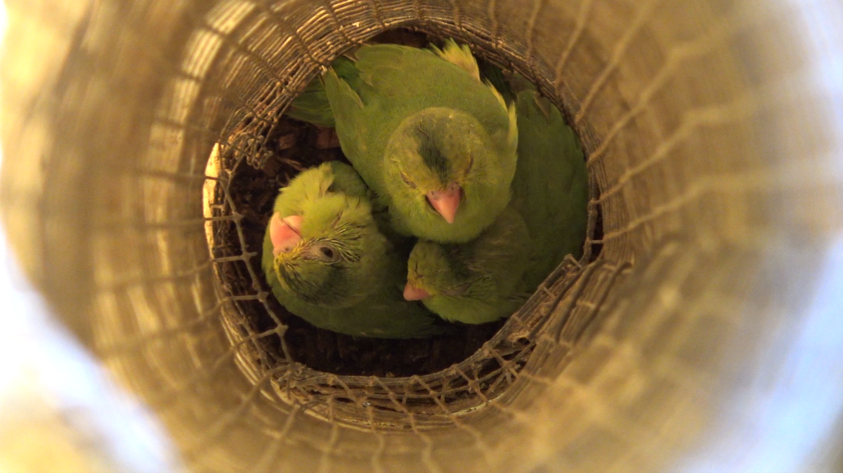
Effects of corticosteroids on vocal babbling in an extremely altricial bird Rory Eggleston

Slide 2
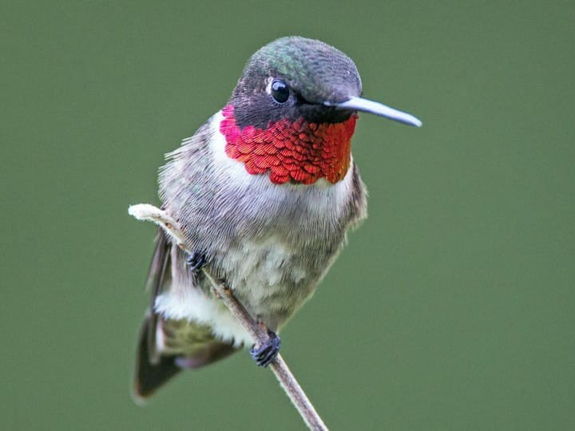
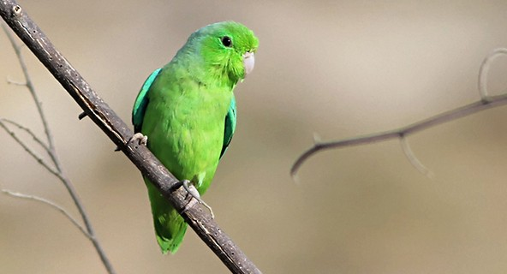
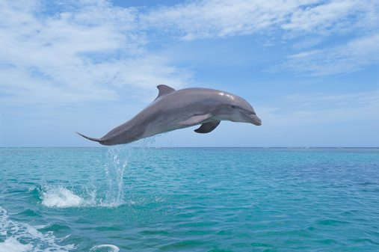
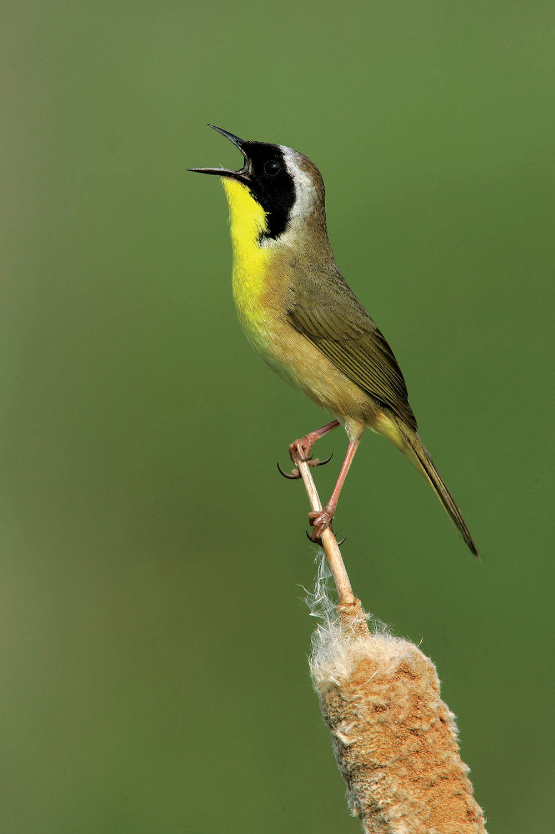

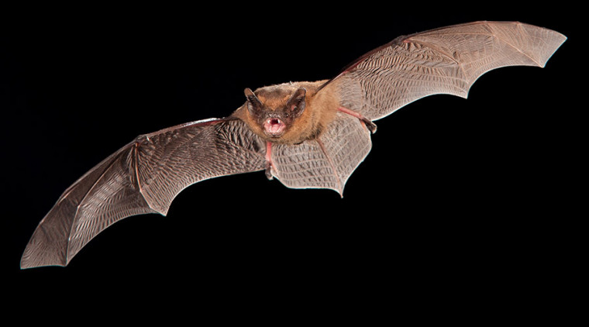
Vocal learning and babbling
The ability to modulate acoustic signals based on environmental stimuli
Vocal learners occur in diverse range of taxa
Sensory and sensorimotor phases
Babbling
Documented in a number of vocal learning taxa
Overproduction of sounds out of context, generally in a continuous stream
In parrotlets, involves the incorporation of both innate and learned vocalizations
CORT and stress

Slide 3
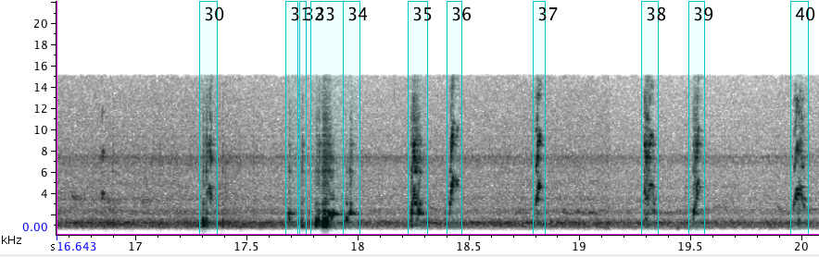
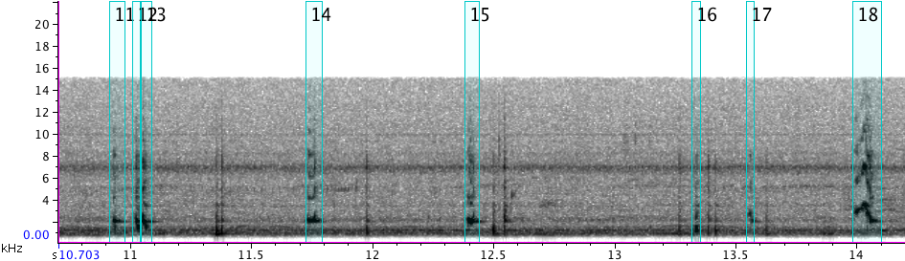
Objectives and hypotheses
Objective
Determine if elevated CORT levels affect the output and signal structure of vocal babbling in Green-rumped Parrotlets (Forpus passerinus)
Hypothesis: CORT plays a significant role in babbling
Supplementing baseline CORT could:
Have an effect on these factors in babbling
Have no effect on these factors in babbling
Have a combination of effects

Slide 4
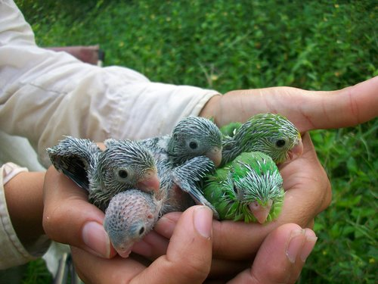
Methods
Organize by treatments
CORT, oil, control
Abandoned clustering
PCA as a base still important
Scikitlearn vs statsmodels PCA
2D histograms
Lots of data overlap
General nestling info-boxplots

Slide 5
Results-PCA
2D histograms
3 PCs
PC1 = 46.01%, PC2 = 15.76%, PC3 = 14.86%

Slide 6
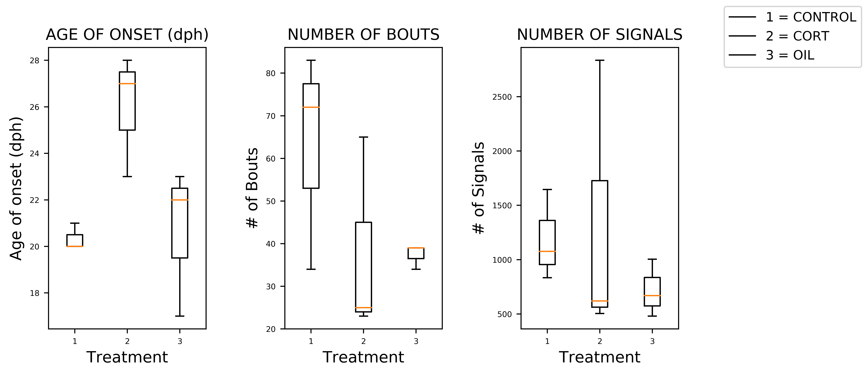
RESults-Boxplots
Nestling data
Age of onset, number of bouts, number of signals
Raw data

Slide 7
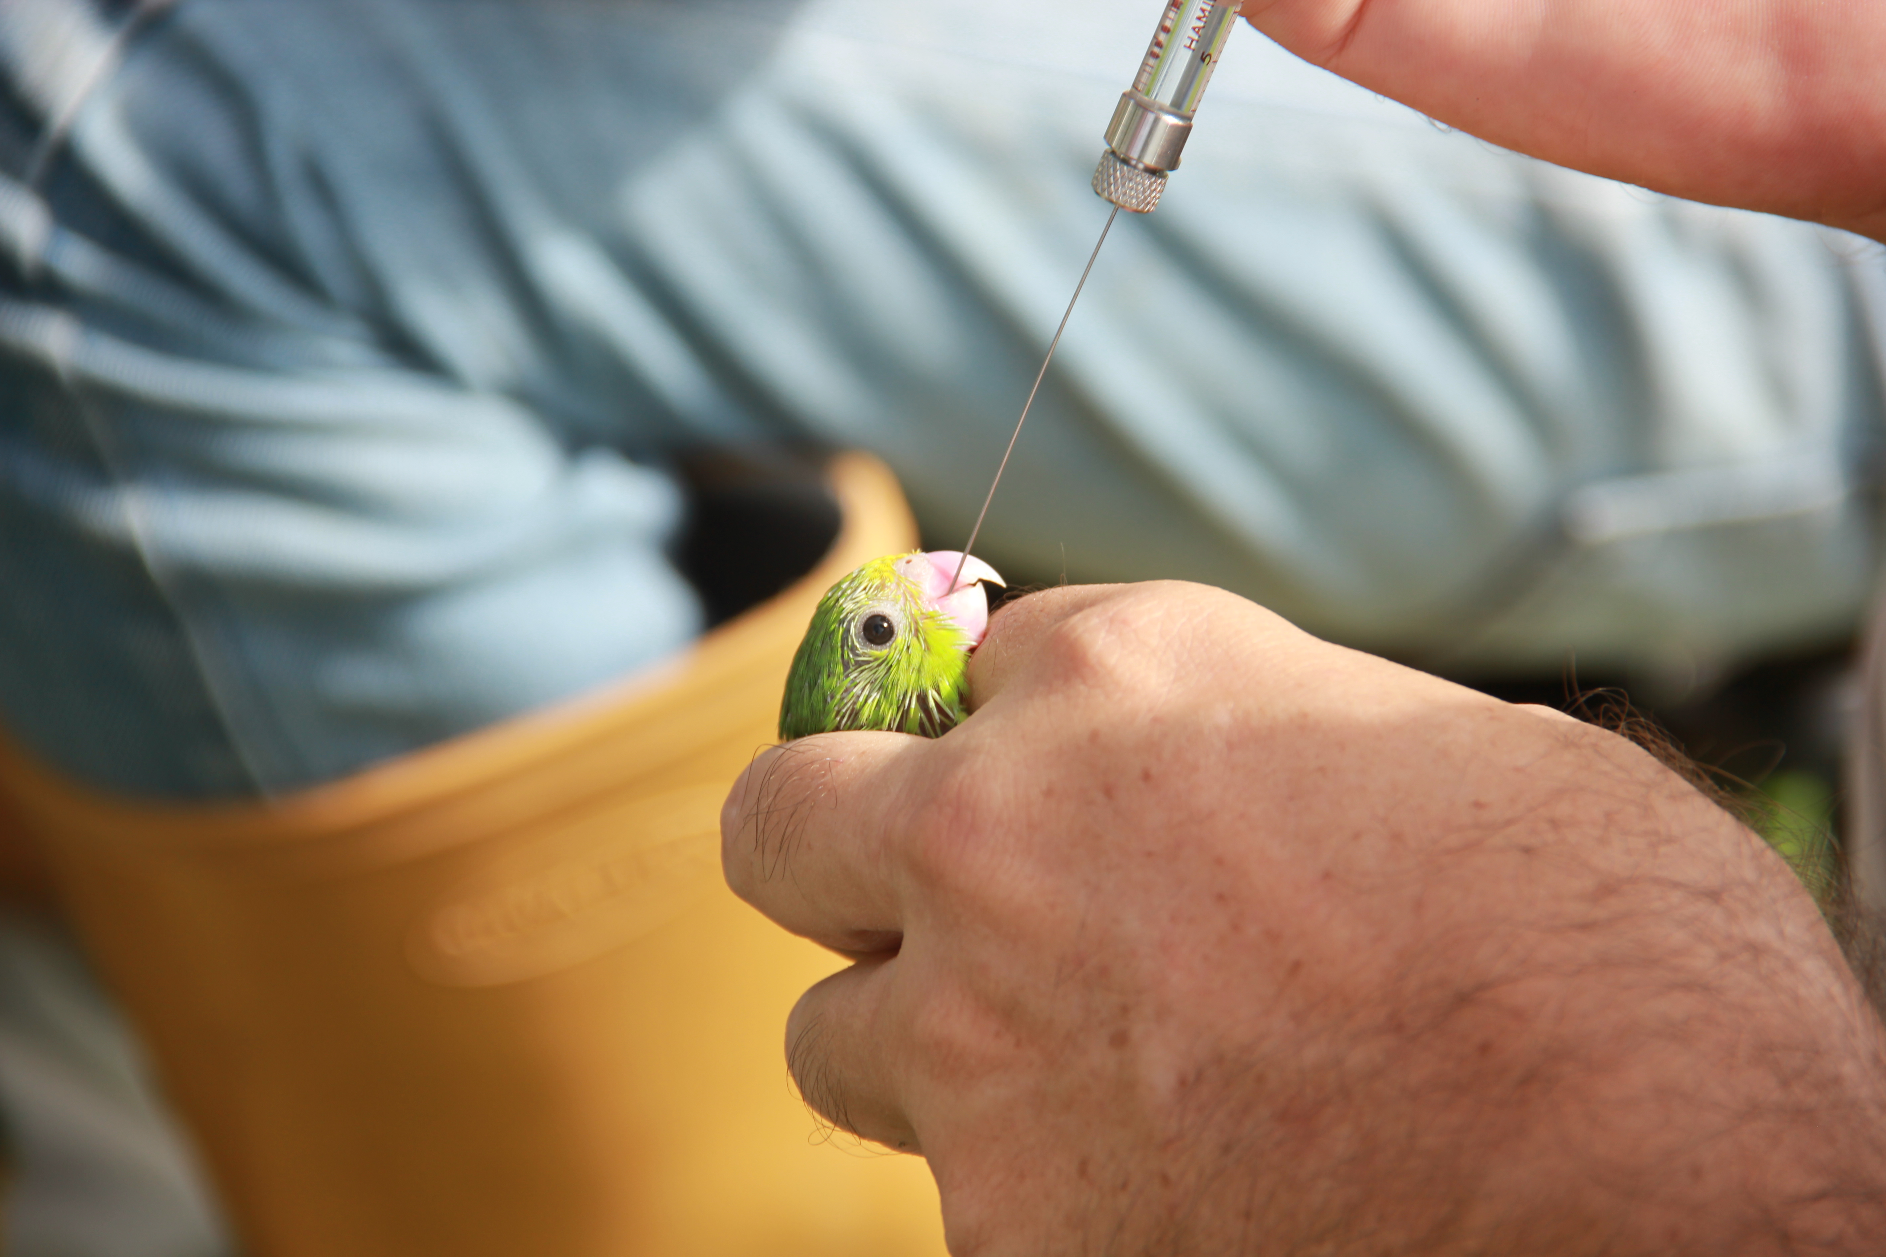
Discussion
PCAs show large overlap in each treatment
More spread in oil, even more in CORT
Most data concentrated in same area
CORT nestlings seem to:
Start later
Have fewer bouts
Large variability in number of signals
Statsmodels overall better
Better documentation
Easier for interpretation

Slide 8
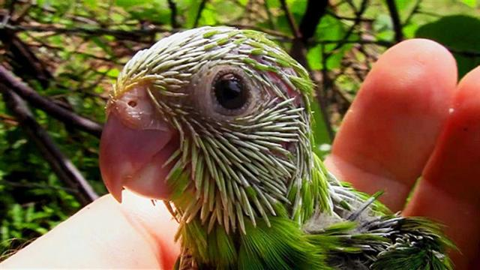
Questions?

